Slide 1
Course Name : Software Engineering
T V Rao
Agile Process Models

Slide 2
Extreme Programming (XP)
The most widely used agile process, originally proposed by Kent Beck
XP Planning
  Begins with the creation of “user stories”
  Agile team assesses each story and assigns a cost
  Stories are grouped to form a deliverable increment
  A commitment is made on delivery date
  After the first increment “project velocity” is used to help define subsequent delivery dates for other increments

Slide 3
Extreme Programming (XP)
XP Design
  Follows the KIS principle
  Encourage the use of CRC cards
  For difficult design problems, suggests the creation of “spike solutions”—a design prototype
  Encourages “refactoring”—an iterative refinement of the internal program design
XP Coding
  Recommends the construction of a unit test for a store before coding commences
  Encourages “pair programming”
XP Testing
  All unit tests are executed daily
  “Acceptance tests” are defined by the customer and executed to assess customer visible functionality

Slide 4
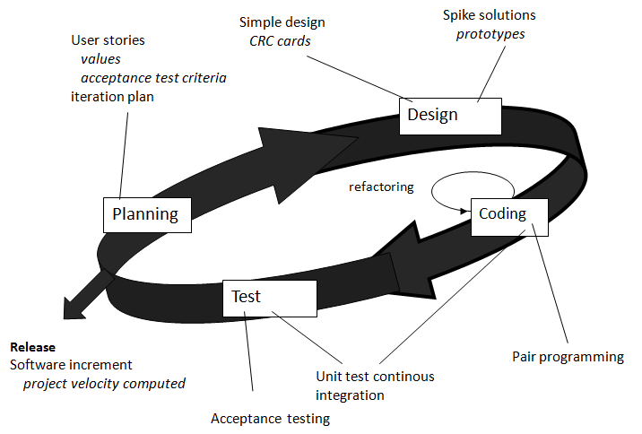
Extreme Programming (XP)

Slide 5
Refactoring
Programming team look for possible software improvements and make these improvements even where there is no immediate need for them.
This improves the understandability of the software and so reduces the need for documentation.
Changes are easier to make because the code is well-structured and clear.
However, some changes requires architecture refactoring and this is much more expensive.

Slide 6
Examples of refactoring
Re-organization of a class hierarchy to remove duplicate code.
Tidying up and renaming attributes and methods to make them easier to understand.
The replacement of inline code with calls to methods that have been included in a program library.

Slide 7
Pair programming
In pair programming, programmers sit together at the same workstation to develop the software.
Pairs are created dynamically so that all team members work with each other during the development process.
The sharing of knowledge that happens during pair programming is very important as it reduces the overall risks to a project when team members leave.
It serves as an informal review process as each line of code is looked at by more than 1 person.
Pair programming is not necessarily inefficient and there is evidence that a pair working together is more efficient than 2 programmers working separately.

Slide 8
Advantages of Pair programming
It supports the idea of collective ownership and responsibility for the system.
  Individuals are not held responsible for problems with the code. Instead, the team has collective responsibility for resolving these problems.
It acts as an informal review process because each line of code is looked at by at least two people.
It helps support refactoring, which is a process of software improvement.
  Where pair programming and collective ownership are used, others benefit immediately from the refactoring so they are likely to support the process.

Slide 9
Industrial XP
Incorporates six new practices to ensure that XP works for significant projects in large organization.
Incorporates six new practices
  Readiness Assessment
    Ascertain environment, team, culture
  Project Community
    Right people – team becomes community
  Project Chartering
    Appropriate business justification within org
  Test-driven management
    State of the project as per measurable destinations
  Retrospectives
    Specialized technical review after delivery of increment
  Continuous learning

Slide 10
Criticism of XP
Concerns expressed by critics w.r.t. XP include
Requirements volatility
  -rework may be unmanageable
Conflicting customer needs
  -team cannot reconcile conflicting demands
Requirements are expressed informally
  -omissions, inconsistencies, errors
Lack of formal design
  -Without architectural design, structure of the software lacks quality and maintainability

Slide 11
Adaptive
Software Development
Originally proposed by Jim Highsmith
ASD — distinguishing features
  Mission-driven planning
  Component-based focus
  Uses “time-boxing”
  Explicit consideration of risks
  Emphasizes collaboration for requirements gathering
  Emphasizes “learning” throughout the process

Slide 12
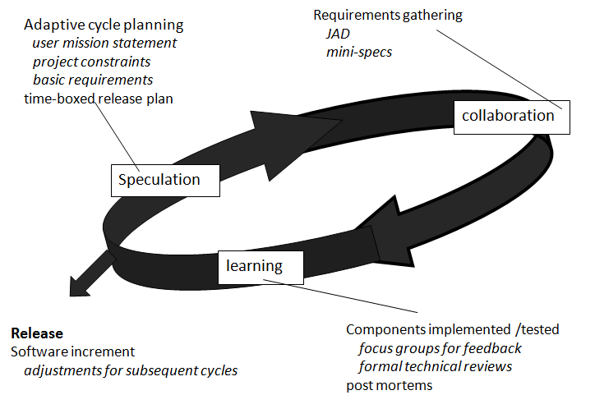
Adaptive Software Development

Slide 13
Dynamic Systems Development Method
Promoted by the DSDM Consortium (www.dsdm.org)
DSDM—distinguishing features
  Similar in most respects to XP and/or ASD
  Nine guiding principles
    Active user involvement is imperative.
    DSDM teams must be empowered to make decisions.
    The focus is on frequent delivery of products.
    Fitness for business purpose is the essential criterion for acceptance of deliverables.
    Iterative and incremental development is necessary to converge on an accurate business solution.
    All changes during development are reversible.
    Requirements are baselined at a high level
    Testing is integrated throughout the life-cycle.

Slide 14
Dynamic Systems Development Method
DSDM life cycle has three iterative cycles preceded by two activities
  Feasibility study
      Is the application a viable candidate for the DSDM process?
  Business study
      Establish functional & information requirements to provide business value
  Functional model iteration
      Build incremental prototypes to demonstrate functionality
  Design & build iteration
      Revisit prototype & engineer it to provide operational business value
  Implementation iteration
      Place the latest software increment (an “operationalized” prototype) into the oprational environment

Slide 15
SCRUM - Introduction
Scrum is an Agile Software Development Process.
Scrum is not an acronym
name taken from the sport of Rugby, where everyone in the team pack acts together to move the ball down the field
analogy to development is the team works together to successfully develop quality software

Slide 16
Scrum
Proposed by Schwaber and Beedle
Scrum—distinguishing features
  Development work partitioned into packets makes up “Backlog”
  Testing and documentation are on-going as the product is constructed
  Work occurs in “sprints” and is derived from a “backlog” of existing requirements
  Meetings are very short and sometimes conducted without chairs
    What did you do since last team meeting
    What obstacles are you encountering?
    What do you plan to accomplish by the next team meeting?
  “demos” are delivered to the customer with the time-box allocated

Slide 17
Agile Unified Process
Adopts “serial in the large” and “iterative in the small” philosophy suggested by Scott Ambler
Adopts UP phased activities – inception, elaboration, construction, and transition
Within each of the activity, team iterates to achieve agility.
UML representations are used, though modeling is kept to bare minimum

Slide 18
Agile Process and Documentation
According to Matt Simons (“Internationally Agile”) , there are two keys to successful documentation on agile projects.
Finding the point of "just enough" documentation. This is difficult to determine and will vary by project. Fortunately, the iterative nature of agile development allows you to experiment until you get it right.
Not get attached to it or have unrealistic hopes of keeping it updated.
“Documentation must be created to serve a specific purpose, and after it has served that purpose you'll all probably have more important things to do than keep updating the documents. It may seem counterintuitive, but it's often better to produce fresh documentation the next time some is clearly required. A side benefit of starting over each time you need to document part of your project is that it's great incentive to keep your documentation efficient!”

Slide 19
Agile Process with Offshore Development
Martin Fowler suggests following successful practices:
  Use Continuous Integration to Avoid Integration Headaches
  Have Each Site Send Ambassadors to the Other Sites
  Use Contact Visits to build trust
  Don't Underestimate the Culture Change
  Use wikis to contain common information
  Use Test Scripts to Help Understand the Requirements
  Use Regular Builds to Get Feedback on Functionality

Slide 20
Agile Process with Offshore Development
(contd)
Martin Fowler suggests following successful practices:
  Use Regular Short Status Meetings
  Use Short Iterations
  Use an Iteration Planning Meeting that's Tailored for Remote Sites
  When Moving a Code Base, Bug Fixing Makes a Good Start
  Separate teams by functionality not activity
  Expect to need more documents.
  Get multiple communication modes working early
Article by Martin Fowler, Author and Member, Agile Alliance

Slide 21
Some challenges with agile methods
It can be difficult to keep the interest of customers who are involved in the process.
Team members may be unsuited to the intense involvement that characterises agile methods.
Prioritising changes can be difficult where there are multiple stakeholders.
Maintaining simplicity requires extra work.
Contracts may be a problem as with other approaches to iterative development.

Slide 22
Agile methods and software maintenance
Most organizations spend more on maintaining existing software than they do on new software development. So, if agile methods are to be successful, they have to support maintenance as well as original development.
Two key issues:
  Are systems that are developed using an agile approach maintainable, given the emphasis in the development process of minimizing formal documentation?
  Can agile methods be used effectively for evolving a system in response to customer change requests?
Problems may arise if original development team cannot be maintained.

Slide 23
Large systems development
Large systems are usually collections of separate, communicating systems, where separate teams develop each system. Frequently, these teams are working in different places, sometimes in different time zones.
Large systems are ‘brownfield systems’, that is they include and interact with a number of existing systems. Many of the system requirements are concerned with this interaction and so don’t really lend themselves to flexibility and incremental development.
Where several systems are integrated to create a system, a significant fraction of the development is concerned with system configuration rather than original code development.

Slide 24
Large systems development
Large systems and their development processes are often constrained by external rules and regulations limiting the way that they can be developed.
Large systems have a long procurement and development time. It is difficult to maintain coherent teams who know about the system over that period as, inevitably, people move on to other jobs and projects.
Large systems usually have a diverse set of stakeholders.It is practically impossible to involve all of these different stakeholders in the development process.

Slide 25
Thank You…

Slide 26
Credits
Software Engineering 7/ed by Roger Pressman – Reference

